Slide 1
Project Name: cost of living
Presented by:
Abhishek Bhowmick

Slide 2
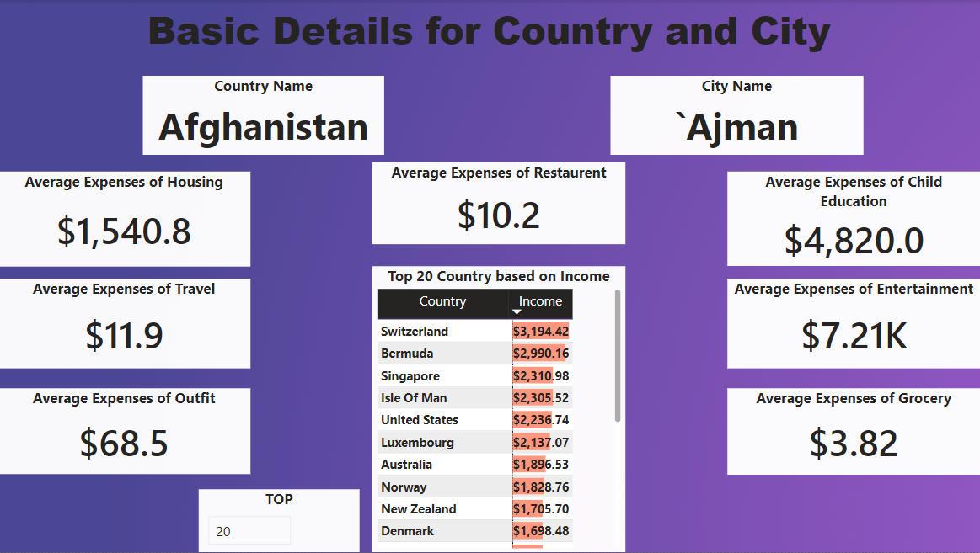

Slide 3
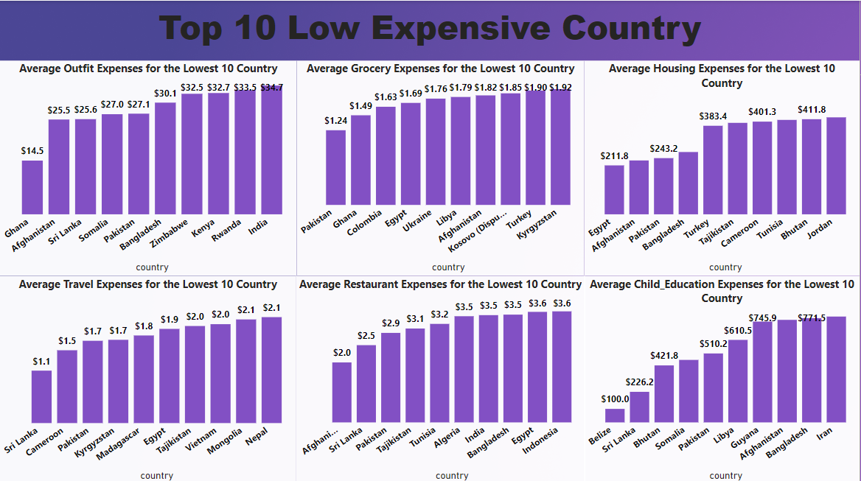

Slide 4
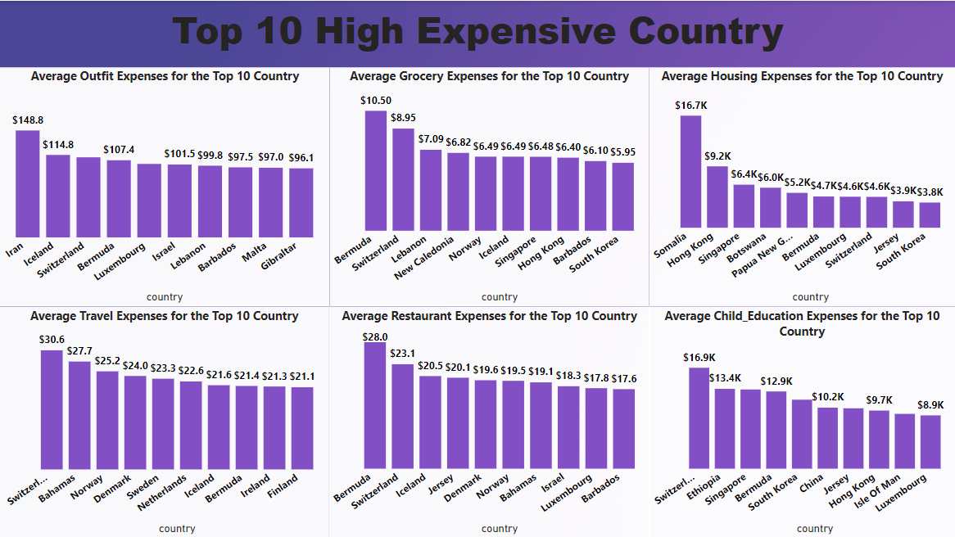

Slide 5


